Slide 1
Accident Severity Prediction
Presented by Dhruvil Sheladiya.

Slide 2
TABLE CONTENT
01 PROBLEM IDENTIFICATION
02 APPROACH TO SOLVE PROBLEM
03 DATASET AND LIBRARIES
04 EDA(EXPLATORY DATA ANALYSIS)
05 TRAIN TEST SPLIT
06 BUILDING CLASSIFICATION MODEL
07 RESULTS AND CONCLUSION

Slide 3
1.PROBLEM IDENTIFICATION
Develop a robust Machine Learning model capable of accurately predicting Accident Severity, incorporating essential variables including Age, gender, Educational level, Driving experience, Type of vehicle', Service year of vehicle and many more.
This model will offer invaluable insights into the multifaceted factors influencing Accident Severity outcomes.
The objective is to construct a predictive framework that elucidates the interplay of diverse factors contributing to Severity, facilitating the maintenance of balanced Driving Experience, Age , gender, Type of Vehicle etc.

Slide 4





2.APPROACH TO SOLVE THE PROBLEM
Collect & Pre processing Data
Model Selection
Modeling
Evaluation
Conclusion

Slide 5
3.Dataset and Libraries
Data Set Information:
PERSON_AGE: The age of the individual expressed in years.
PERSON_SEX: Gender of individual categorized as male or female.
CRASH_DATE: Total days in a week.
PERSON_TYPE: How much person is educated.
SAFETY_EQUIPMENT: Experience of person who is driving.
POSITION_IN_VEHICLE: Vehicle is Government , private or other
EJECTION: How accident happen.
PERSON_INJURY: the person is serious injury, fatal injury, slight injury
Libraries:
Pandas: To Process the data as the data was in CSV format
Matplotlib and Seaborn : It is commonly used for data visualization and creating various types of charts and plots
Scikit-learn: Scikit-Learn, also known as Sklearn is a python library to implement machine learning models and statistical modelling
Xgboost: is a powerful and efficient implementation of gradient boosting algorithms optimized for performance and speed.

Slide 6
4.EXPLORATORY DATA ANALYSIS
FUNCTION | OPERATIONS
df=pd.read_csv(“”) | Importing our dataset into Data frame and storing in df (i.e variable) (pd refers to pandas).
df.head(), df.tail() | To Display the first 5 Rows and last 5 Rows .
df.shape() | array dimensions that tells the number of rows and columns of a given Data Frame.
df.describe() | Provides summary statistics of data like mean, median, minimum, maximum and more
df.info() | Display columns ,datatypes, non-null count and memory usage
df.isnull().sum() | Check the Total missing /null values.
df.duplicated().sum() | Check the duplicate values.

Slide 7
5.TRAIN TEST SPLIT
random_state=42: This parameter sets the random seed for reproducibility. It ensures that the split is deterministic and consistent across different runs.
random_state=42: This parameter sets the random seed for reproducibility. It ensures that the split is deterministic and consistent across different runs.
We will split our dataset into 80% to 20% ratio
Where X =Prediction variable and y = target variable
Split the dataset using below code…
X_train, X_test, y_train, y_test = train_test_split(X, y, test_size=0.2, random_state=42)

Slide 8
6.Building Classification Model
We have used 2 Algorithm to find out the best accuracy according to our variables:
Random Forest Classifier
A random forest (RF) classifier is a machine learning algorithm that combines multiple decision trees to produce a single result. It's a type of ensemble-based learning method that's simple to implement, fast, and has been successful in many domains.
Gradient Boosting Classifier(XGboost)
A gradient boosting classifier is a machine learning technique that combines multiple weak learning models to create a stronger predictive model. It's known for its accuracy and speed, especially when working with large and complex data sets.

Slide 9
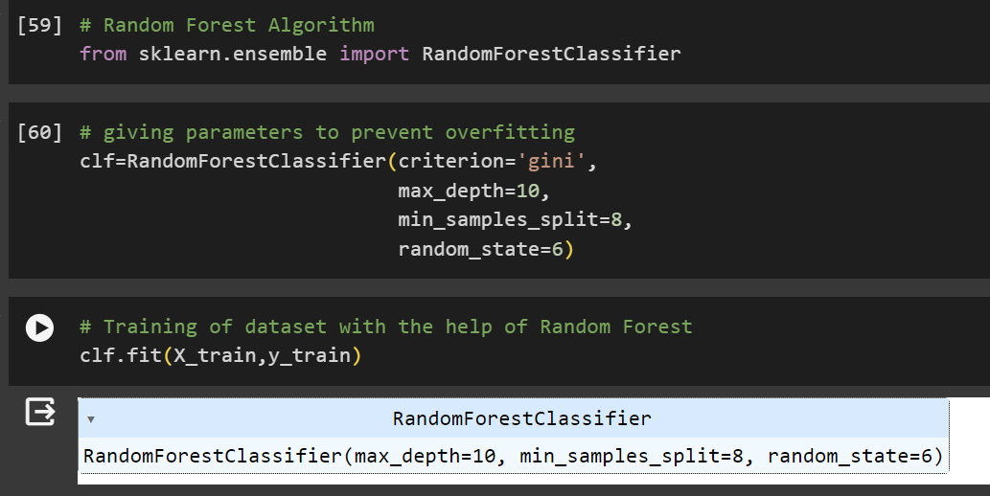
Random Forest Classifier
Importing Algorithm And training the model

Slide 10
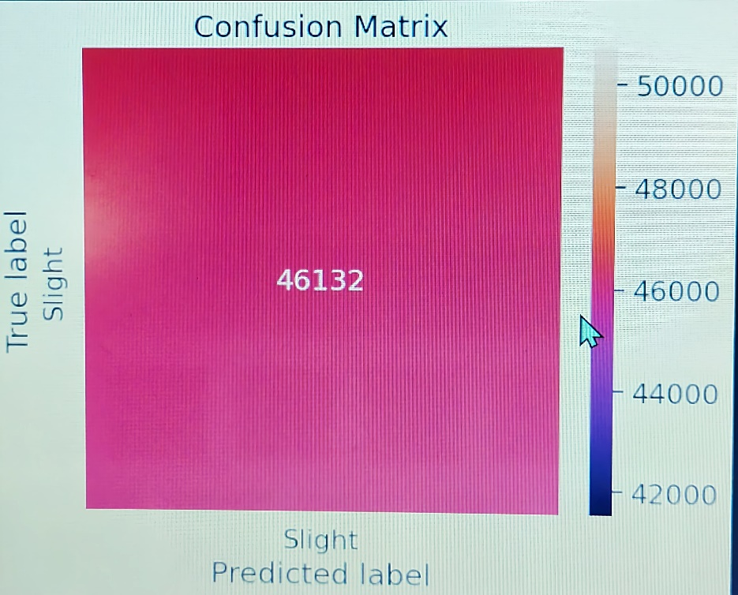
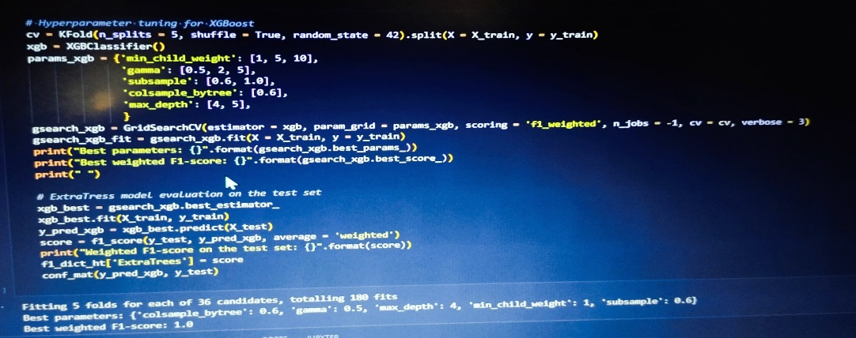
XGBOOST Classifier
Xgboost classifier and its output

Slide 11
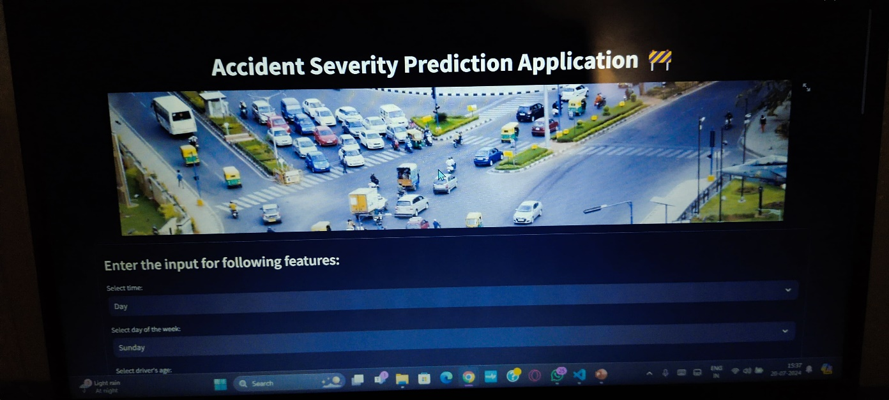
7.Results and Conclusion
FINAL RESULT
Car accident severity prediction is a crucial application in the field of machine learning and data science, aimed at reducing the impact of road accidents by predicting the severity of accidents based on various factors. Here are the key points and conclusions from implementing a car accident severity prediction model:
Objective
Data Collection
Exploratory Data Analysis (EDA)

Slide 12
Questions ?

Slide 13
Thank You!

